Slide 1
Water Supply Situation Report
CCWA Operating Committee Meeting
January 11, 2024

Slide 3
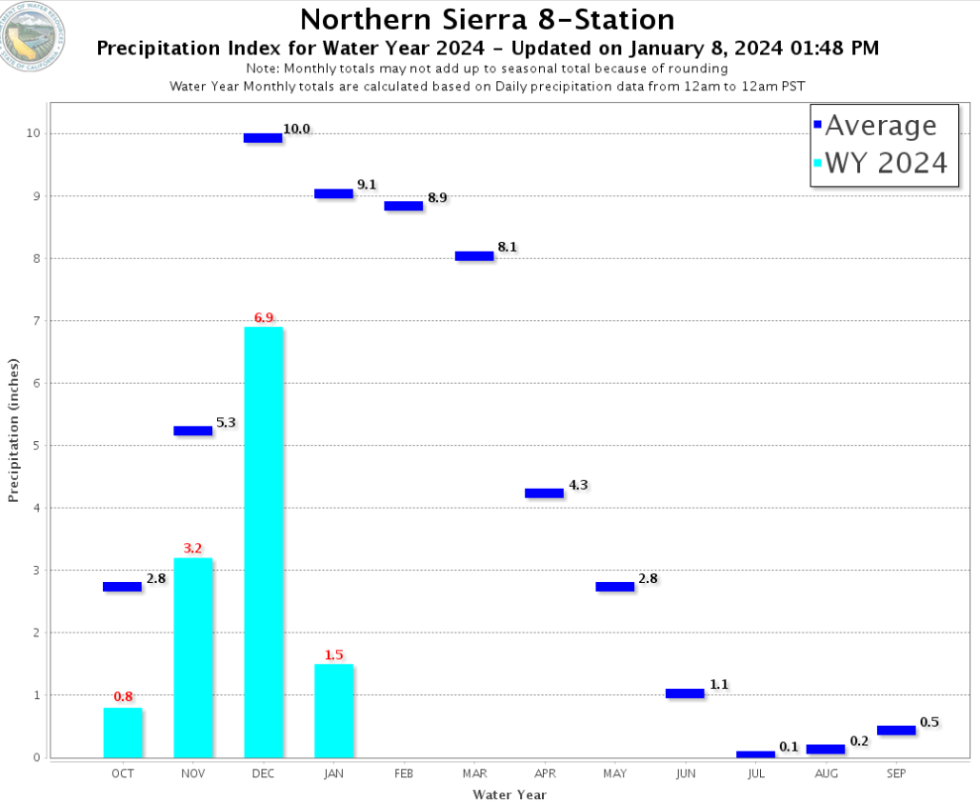

Slide 5
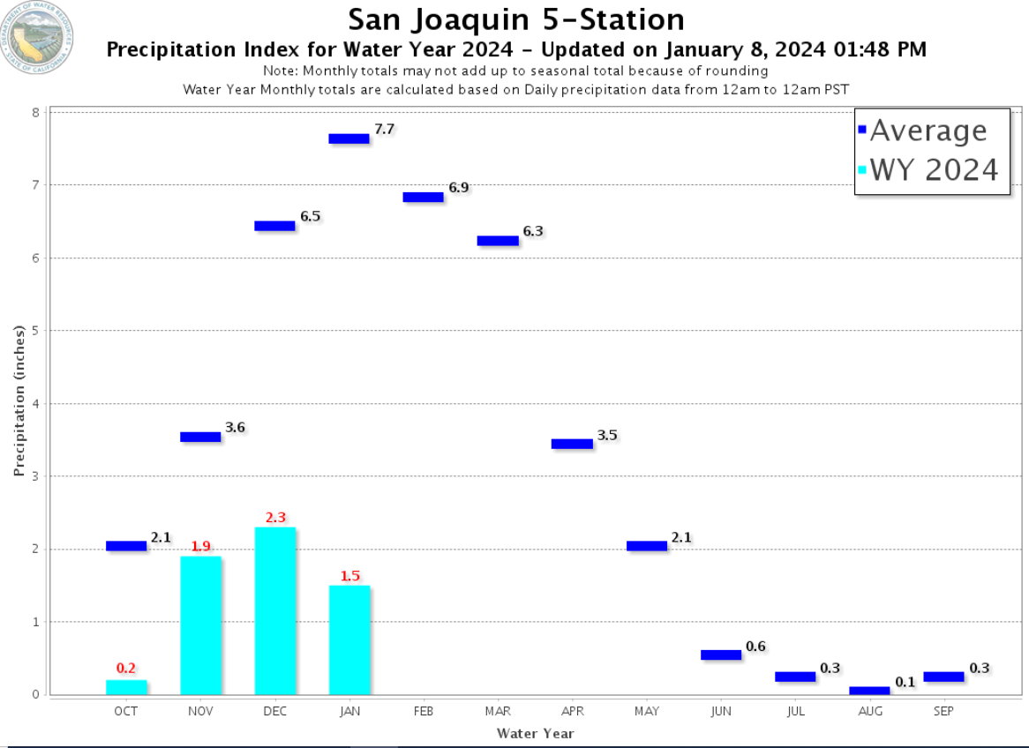

Slide 7
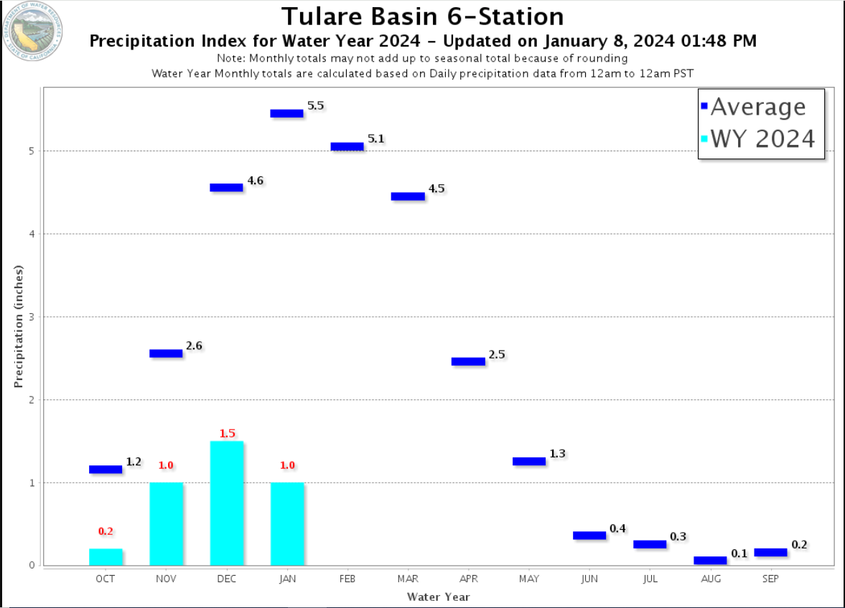

Slide 12
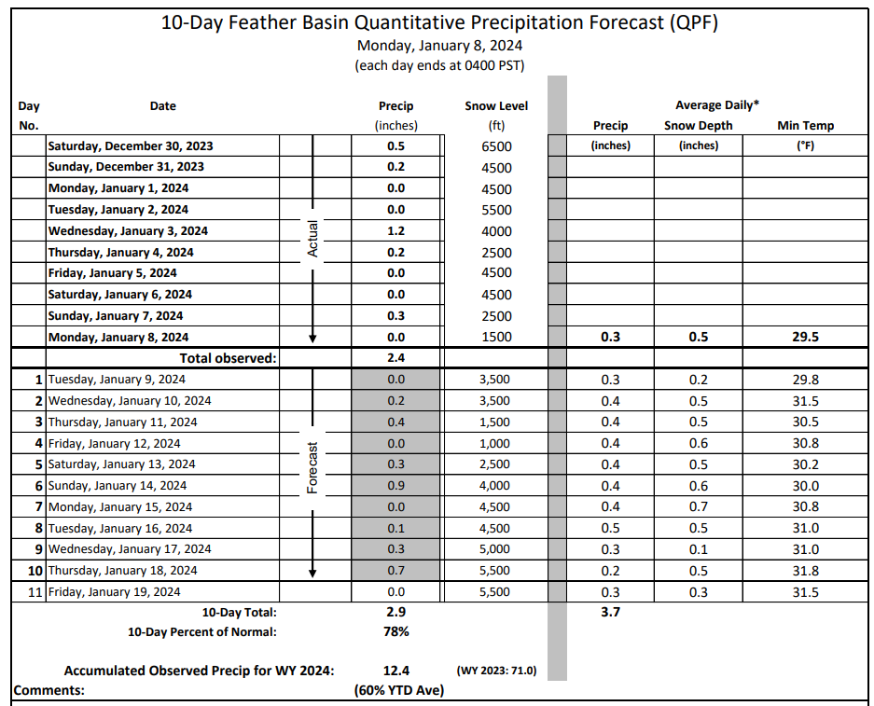

Slide 13
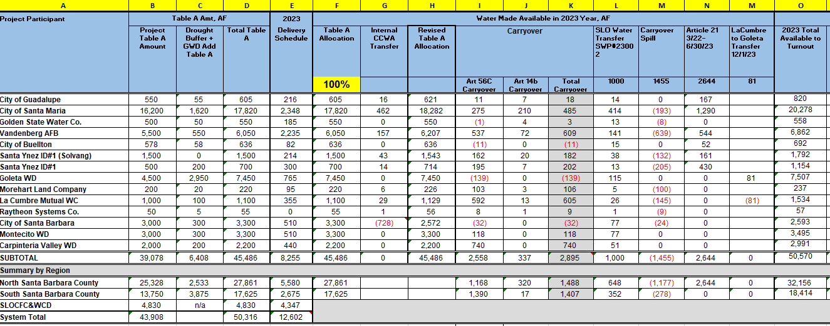

Slide 14
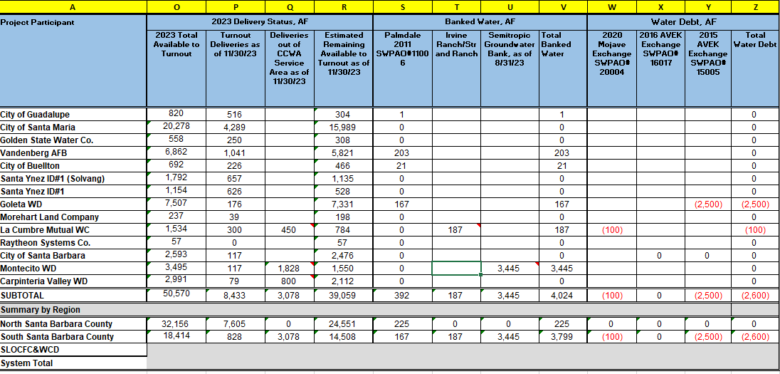

Slide 15
Highlights
The State’s share of San Luis Reservoir is below 400 TAF and therefore currently not a high risk of spill or the loss of carryover.
DWR has about 800 TAF of carryover owed to the SWP Contractors for 2023, but only around 400 TAF in San Luis
No increase in 2024 allocation until DWR has met the 800 TAF obligation for 2023
Conditions could change rapidly and dramatically as occurred in early 2023
SWC working on an “internal” water database to match sellers and buyers for 2024 before going outside of the SWC Contractors for purchases (dry year transfer program)

Slide 16
Questions?

