Slide 1

CCWA FY 2025/26 Preliminary Budget
Board of Directors meeting
March 27, 2025

Slide 2
Budget Overview in Total
Preliminary FY 2025/26 Budget: $58 million
Final FY 2024/25 Budget: $60.2 million
Preliminary Budget decrease of $2.2 million
  $562,575 - Increase in CCWA O&M expense
  $(144,974) - Decrease in CIP/NCIP expense
  $(844,165) - Decrease in DWR and Warren Act expenses
  $ 1.7 million increase in CCWA O&M Credits

Slide 3
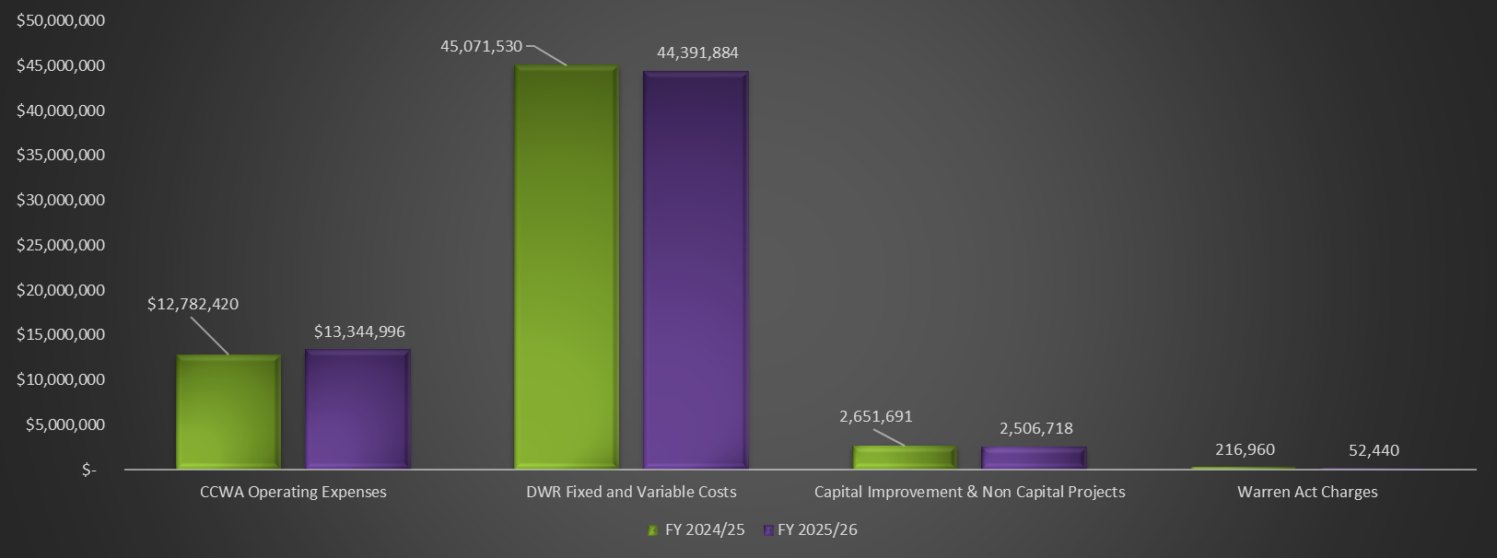
Proposed Preliminary Budget - FY 2025/26

Slide 4
FY 2025/26 Draft Budget

Slide 5
CCWA Budget: 26% - DWR Budget: 74%

Slide 6
Budget Credits
Notes:
CCWA policy is to refund unexpended operating assessments( O&M and CIP) and investment income after the close of the Fiscal year. The reconciliation occurs in conjunction with the closeout of the FY and preparation of the annual financial statements. All excess revenues are returned to the project participants and deficits are collected. General fund balance equals CASH minus RESERVES= ZERO

Slide 7
Reserves and cash management
DWR Reserve Fund-$6.3 Million
Purpose: provide funding source for unanticipated DWR costs billed in the SOC
Participation: Voluntary
Policy adopted by BOD: March 2019
  CVWD, MWD, GWD and Vandenberg SFB do not participate
  Funds are invested and generate monthly interest
Notes:
Additional information on fund contributions, withdrawals and administration is available in the budget underthe reserves and cash management section.

Slide 8
Reserves and cash management
O&M Fund-$2 Million
Purpose: provide funding source for unanticipated O&M expense and emergency repairs
Participation: Mandatory
Policy adopted by BOD: December 1997
  Funds are invested and generate monthly interest
Notes:
Fund are invested in highly liquid money market accounts ( LAIF, Treasury money funds)

Slide 9
Reserves and cash management-REVIEW
Rate Coverage Fund-$9.9 Million
Purpose: ensure compliance with Water Supply Agreement rate coverage obligation
Participation: Voluntary
Policy adopted by BOD: December 1997
  Funds are invested and generate monthly interest
  9 participants
  Collect 125% of contract payments
Notes:
The rate fund is intended to provide a mechanism to allow member agencies to satisfy apportion of their obligation under the WSA to impose rates and charges sufficient to collect 125 % of their contract payments.

Slide 10
CCWA Investment Pool
Notes:
All CCWA cash and investments paid by the project participants are invested in accordance with the Authority’s investment policy.

Slide 11
CCWA Budget

Slide 12
Cost Allocation
Administration Department
  Table A amounts - SLO County excluded
Water Treatment Plant
  Table A amounts - SLO County included
  Retreatment and Exchange Adjustment
Distribution
  Financial reaches/location on pipeline
    CCWA Reaches-From Vandenberg to Cachuma
    DWR Reaches
    Beneficiaries pay the cost
Notes:
Distribution cost center: SLO county has cost allocated based on capacity( reach 33 B, reach 34)

Slide 13
Regional Water Treatment Plant Allocation
Purpose: Methodology used to ensure all participants pay the same cost per AF to treat State Water.
All Santa Barbara County participants pay a retreatment charge using a retreatment allocation factor
South Coast participants receive a retreatment credit to cover cost of retreating the State water.

Slide 14
Santa Ynez Exchange Agreement
CCWA owns 5-mile-long pipeline from Lake Cachuma to SYID#1
So. Coast participants take Cachuma water in exchange for State water to SYID#1
So. Coast participants take water that equals SYID#1 annual allocation of Cachuma water
FY 2025/26 Exchange-2,425 AF

Slide 15
Santa Ynez Exchange Agreement
Benefits
SYID#1- No need to build a WTP to treat water and lower capital cost due to existing pipeline in place
So. Coast participants receive cheaper water- Only pay for DWR variable OMP&R costs
SYID#1- pays for variable and fixed costs to treat the Exchange water and for the regional water treatment plant allocation

Slide 16
Cost Allocation
Administration Department
  Table A amounts - SLO County excluded
Water Treatment Plant
  Table A amounts - SLO County included
  Retreatment and Exchange Adjustment
Distribution
  Financial reaches/location on pipeline
    CCWA Reaches-From Vandenberg to Cachuma
    DWR Reaches
    Beneficiaries pay the cost
Notes:
Distribution cost center: SLO county has cost allocated based on capacity( reach 33 B, reach 34)

Slide 17
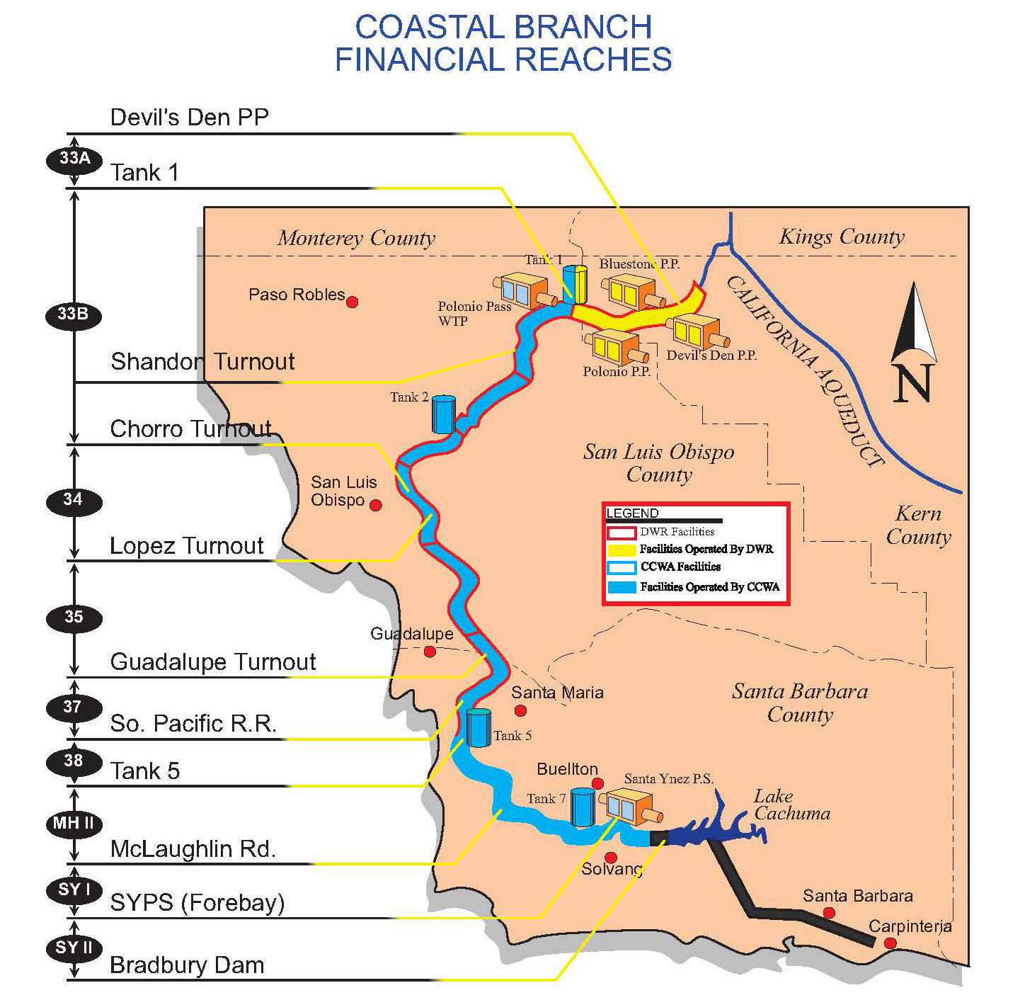
Notes:
Reach 33 A- CCWA pays 90% of costs and SLOC pays 10%. Reach 33 A- Bluestone PP, Polonio Pass and Devil’s Den PP)
Reach 34- SLO county has a share based on capacity/proportionate use

Slide 18
CCWA Operating Expense - $13.3 M
Notes:
This is the consolidated department ANTICIPATED operating expenses.

Slide 19
CCWA Operating Budget
Increase over FY 2024/25 Budget
Personnel - Salaries, Health insurance-4%
Insurance and Computer expense - 13%
Professional services - 20%
Decrease over FY 2024/25 Budget
Utilities – Santa Ynez Pumping Plant variable electric
  Pumping cost per AF increases from $400 to $417
  Lake deliveries decrease from 1,304 AF to 437 of pumped AF

Slide 20
Capital Projects FY 2025/26 Budget
$2,089,868
Mesa Verde and Tank 7 Access Roads Project
$472,500 in project cost
Charging Stations
$116,078 in project cost
OSHA staircase for Tank 2, Tank 5 & Backwash Tank
$378,000 in project cost
Goal: Compliance with Clean Fleet Regulations
Goal: Safety and Regulatory compliance
Location-SYI/SYII
Goal: Safety and preventative maintenance
Scope: full reconstruction
Scope: construct concrete foundations and staircases
Location: WTP/MHI/33B
Location: ADM/WTP/SYII
$17K grant funds from SB APCD
Notes:
Total new budgeted CIP: 22; NCIP-9 PLUS prior year carryover projects. Capitalization criteria: > $10,000 in cost; . 5 years estimated useful life; additions, expansion to capacity; increase in productivity, capacity, efficiency; replacement of major components

Slide 21
Non-Capital Projects FY 2025/26 Budget
$416,850
Facilities Condition Assessment
$241,500 in project cost
Other
Total Capital Projects :22
Location: Reach WTP/ALL/ADM
Goal: Develop a long-term plan for future capital outlays and maintenance needs
Total Non-Capital Projects: 9

Slide 22
FY 2025/26 Budget Roadmap
Preliminary Budget
FY 2025-2026
March 27, 2025
Final Budget
FY 2025-2026
April 24, 2025
DWR Statement of Charges(soc)
July 1, 2025
FYE
June 30, 2026
  Develop CCWA O&M and CIP budget
  Assumptions for DWR Costs:
  Actuals from CY 2025 Statement of Charges-7/1/2024
  Estimates from CY 2026 Statement of Charges-7/1/2025
    CY 2026 Transportation Capital (Devil’s Den repairs)
    CY 2026 Trans. Min
    DWR Var OMPR Rate
    CY 2026 Delta Water rate
    Coastal Branch Phase II-amortization sch. thru 2029
  Review Capital Projects:
      Performance Measures-GFOA mandated req.
      10-year Financial Plan
  Update DWR Cost components as needed per CY 2026 SOC
    Present a summary report to the Board on findings:
      Send Supplemental Bill due 1/1/26
      Reallocate between cost centers
      Ongoing Discussions with DWR
  Projected YE DWR Liability Account balances
  Variable cost true up
  Annual Audit/ACFR
  Year end Credit Payable
Notes:
DWR budget is based on a CALENDAR YEAR( JAN-DEC). CCWA budget is based on a FISCAL YEAR ( JULY-JUNE). DWR is currently working on the SOC for CY 2026 which is based on their adopted budget for CY 2026.

Slide 23
FY 2025/26 DWR Fixed Costs
Notes:
Under the WSA( take or pay contracts), the water purveyors must pay certain fixed costs each year irrespective of how much water the State can deliver or how much water the purveyor needs. By 1963 most of the SWP water conservation and delivery systems and facilities were constructed. These fixed cost are the largest part of the delivery system representing the costs to finance, build and operate the dams, reservoirs, aqueducts and pipeline to conserve and transport the water.
these are

Slide 24
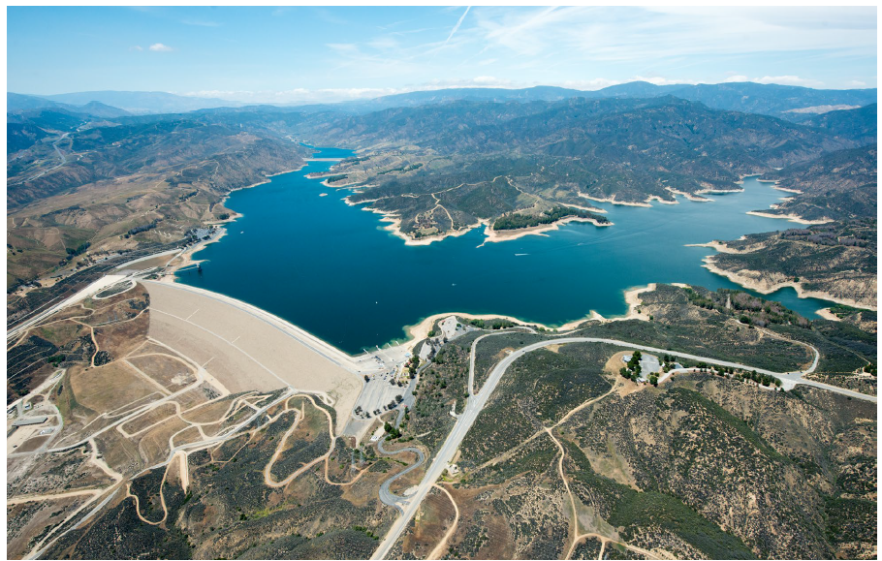
FY 2025/26 DWR Fixed Costs
Allocated to participants based on Table A amounts
Notes:
CCWA is the 3rd largest payer of SWP capital costs behind Metropolitan and Kern due to the fact that CCWA facilities were constructed much later in 1996. DWR has a cost reimbursement contract with the 29 SWC. Conservation and Transportation capital cost components will return to DWR all reimbursable capital costs. Conservation and Transportation minimum ( OMPR) will return to DWR all reimbursable operating cost that do not depend on or vary with the quantities of water delivered.

Slide 25
DWR Cost Components
Significant changes
Transportation Capital
Increase of $1.3M in charges
Transportation Minimum
Decrease of $1.4M over 2024/25 budget
$1 Million included for Devil’s Den Pumping Plant capital cost
2024/25 budget exceeded actual
Rate Management Credits not available
Over/under true up decrease
Notes:
Transportation Capital: SWP Coastal Branch facilities were completed in 1998 for $ 595Million. $481 Million is the DWR project cost which will be fully repaid in 2035. WTP construction cost of $43 Million and $71Million cost for the CCWA pipeline were repaid in Oct 2023( they were financed by revenue bonds). Coastal Branch Extension ( reach 37 and 38) –this is direct debt service on bonds issued by DWR to finance the construction of pipeline in those reaches.

Slide 26
DWR Cost Components
Rate Management Credit
No Rate Management Credits anticipated in CY 2025 and CY 2026
Notes:
DWC: Unit charge/ cost per AF as repayment of all outstanding reimbursable costs of the DWR project conservation facilities( dams, reservoirs, power facilities) San Luis Reservoir; including environmental cost
WSRB- decrease due to prior year overallocation

Slide 27
DWR Variable cost-$3.2M.
(Transportation and power cost to move water through the SWP facilities to SWC turn-outs)
Notes:
Here is the composition of DWR costs.7% var and 93% fixed. Variable cost will increase with deliveries and power/energy costs. The transportation variable OMP&R component will return to DWR all reimbursable operating expenses that depend on and vary with quantities of water delivered to the SWP water contractors.

Slide 28
DWR Variable cost

Slide 29
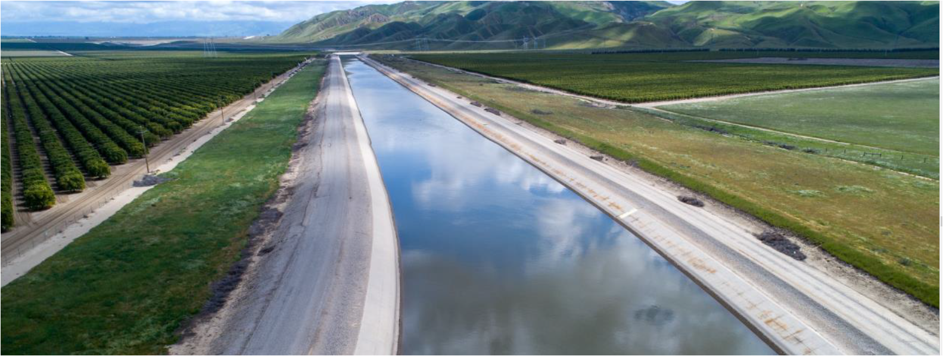
DWR Variable costs
$0.2 M decrease over FY 2024/25 Budget
Var OMP&R - $3,208,819
  FY 2025/26 Unit Rate: $251/AF
  Requested water deliveries Santa Barbara County: 12,784 AF
  Off Aqueduct charge: $3/AF

Slide 30
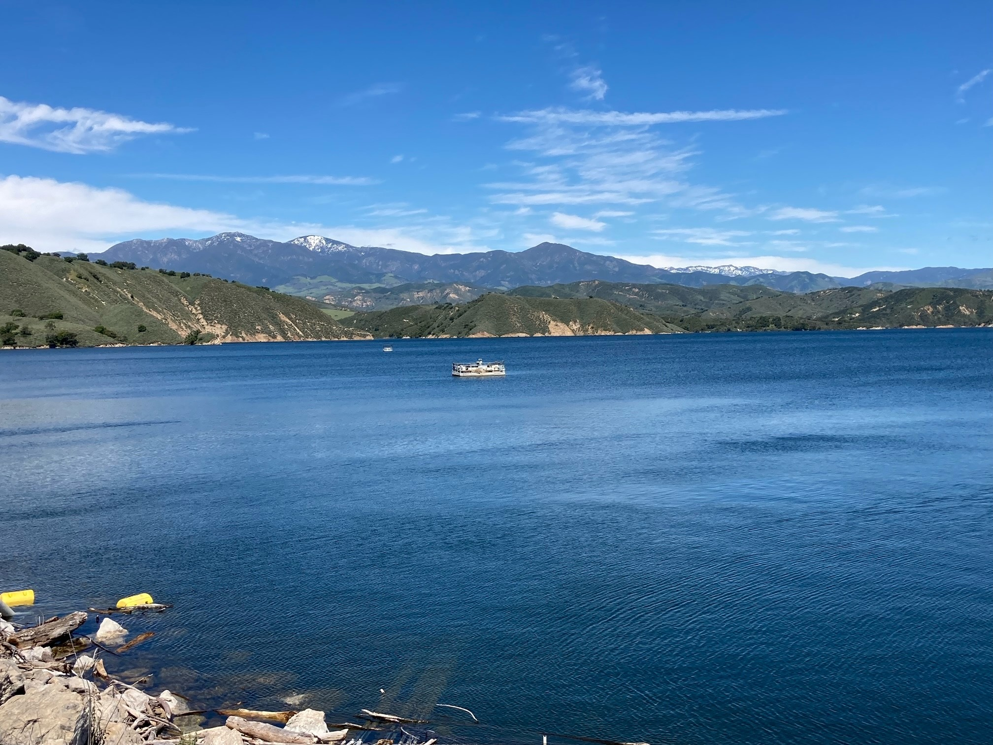


Warren Act and Trust Fund payment
$52,440
Contract between USBR and CCWA for annual introduction, storage, and conveyance of up to 13,750 AF into Cachuma Project facilities
Contract term- expires June 14, 2027
Notes:
USBR: United States Bureau of Reclamation

Slide 31
Warren Act and Trust Fund payment
$52,440
Rate per AF: $ 120
  $77/AF-Warren Act storage & conveyance rate
  $43/AF-COMB
Requested lake deliveries: 437 AF
Decrease over FY 2024/25 Budget of $165K
Notes:
COMB-joint powers authority and public entity which operates and maintains Cachuma Project facilities pursuant to a transfer of operations and maintenance contract. CCWA pays $43/AF to COMB for each AF introduced into Cachuma lake under MOU, Article 3. payments are made quarterly and are based on actual deliveries. These are variable charges.

Slide 32
FY 2025/26 Participant payments
Fixed Assessments
  May 1, 2025-Invoices mailed to participants
  June 1, 2025-Fixed Payments Due
  July 1, 2025-DWR issues CY 2026 SOC
  July Board meeting-True-up between Statement Of Charges (SOC) and budget
Variable Assessments
  Billed quarterly
  Variable deposits billed based on delivery estimates and budgeted rates (DWR Var OMP&R, CCWA Variable cost/AF - SYPP electric, WTP, Warren Act, etc.)
  Variable expenses true-up mid year and year end

Slide 33
FY 2025/26 Goals
Pursue resolution of the outstanding CCWA Statement of Charges protest items
Protect CCWA’s interests as DWR pursues resolution of billing errors
Begin electrifying CCWA vehicle fleet
Initiate a WTP and Distribution facilities condition assessment

Slide 34
